Slide 1
Analysis and Design of
Online Tutoring System
Speaker: Gao Guangyu
Members: Shen Chao, Chen Yanjie,
Pan Yan, Wang Yilian,
Chen Quanyu

Slide 2
Function Hierarchy Graph
Matching Students and Tutors
Giving Lessons
FAQ Platform

Slide 3
Function Hierarchy Graph
Giving Lessons
Matching Students and Tutors
Matching Students and Tutors
Communication
Virtual Blackboard
Video & Audio
FAQ Platform
Words Typing
Other Operations

Slide 4
What is Red5 ?
Red5 Media Server delivers a powerful video streaming and multi-user solution to the ©Adobe ©Flash Player and other exciting client technologies. It based on Java and some of the most powerful open source frameworks

Slide 5
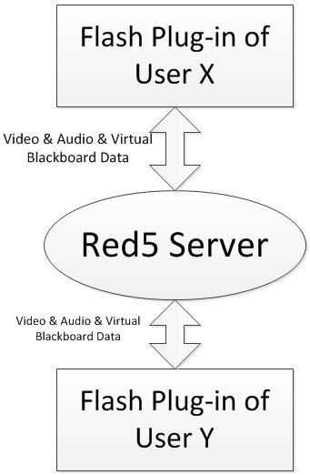
Data Flow Diagram
Data of Flash Plug-in

Slide 6
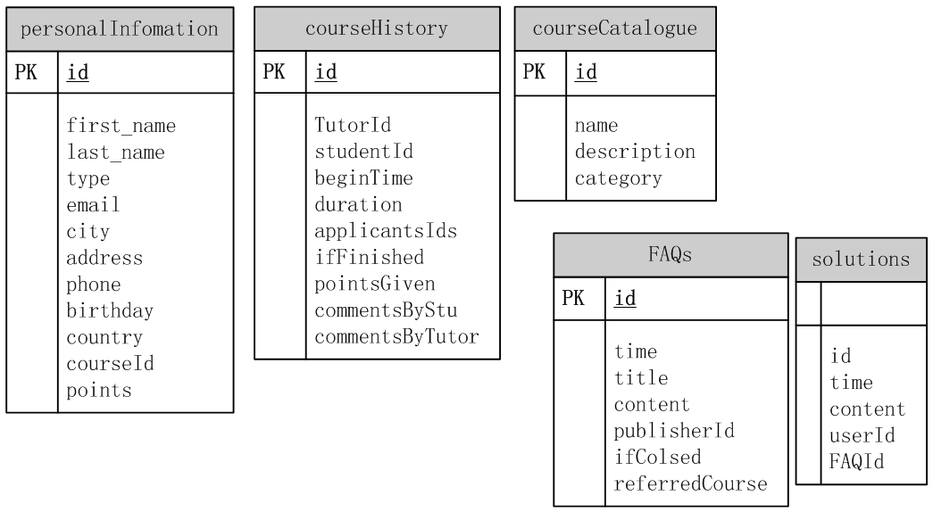
Database Design

Slide 7
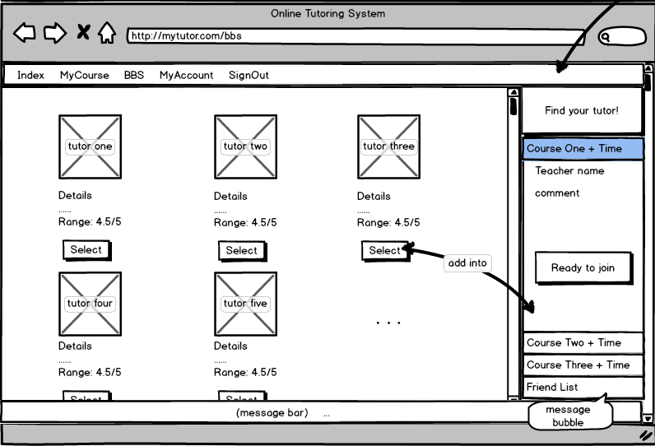
UI Design

Slide 8
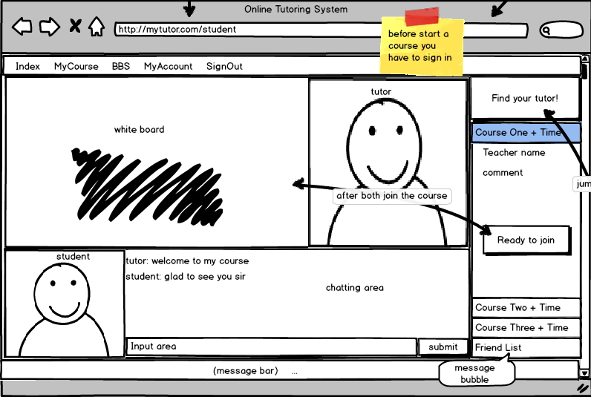
UI Design

